Slide 1
STATE LEVEL ETHNICITY IDENTIFICATION USING HANDWRITTEN TEXT ANALYSIS
Team Members:
BADIGINCHALA CHANDANA PRIYA (20BCS026)
LALAM DIVYA SRI (20BCS076)
RAVULA VEEKSHITH REDDY(20BCS111)
HARSHITA NG (20BCS055)

Slide 2
CONTENTS
1
INTRODUCTION
2
Data set
3
METHODOLOGY
4
RESULTS
5
Conclusion

Slide 3

INTRODUCTION
Handwritten text analysis offers a unique perspective in providing insights into the cultural analysis.
Developing a methodology using Histogram of Oriented Gradients (HOG) for feature extraction that can accurately identify the ethnicity of individuals based on their handwriting patterns.
Addresses challenges faced by traditional biometric methods in adverse conditions.
Emphasizes the need for robust methods in the absence of constraints on age, gender, pen, paper, or writing style.

Slide 4

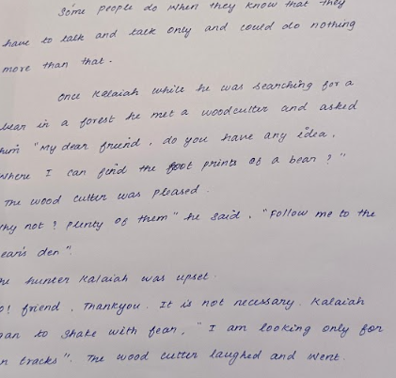
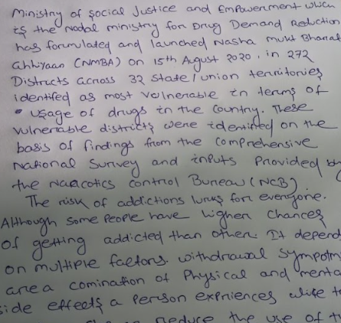

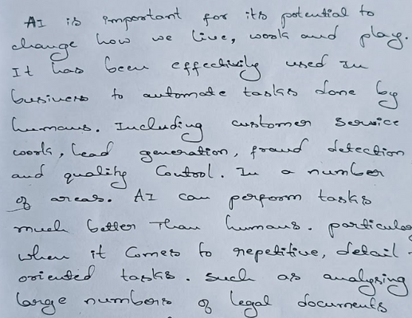
DATA SET
Collected handwritten text images from five different states, with each state containing several images.
ANdhra
tamilnadu
odissa
kerala
karnataka

Slide 5

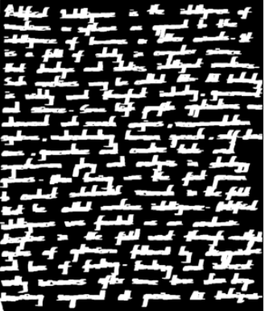
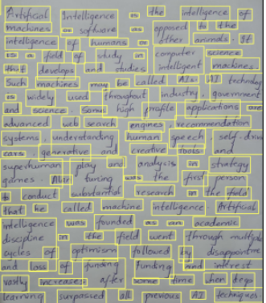
METHODOLOGY
Preprocessing :
Convert image to Grayscale
Dilation
Contour Detection for Line Segmentation
Bounding Box for Segmentation
Apply Canny edge detection on each extracted word .

Slide 6

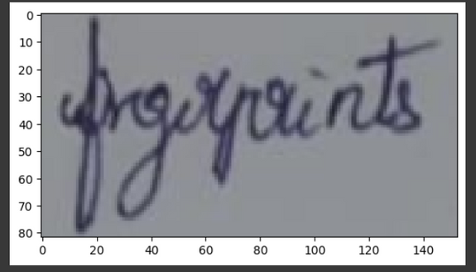
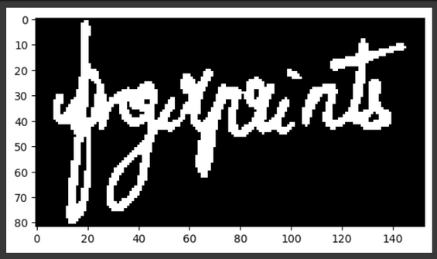
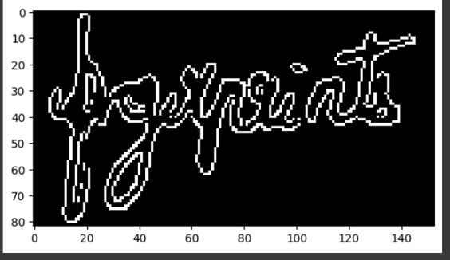
Extraction of Word through bounding box segment
Dilation and binarization of extracted word
Canny edge image

Slide 7
Histogram of Oriented Gradients (HOG) for Feature Extraction:
The technique counts occurrences of gradient orientation in the localized portion of an image.
It uses Sobel operators to obtain gradient magnitude and direction of pixels. Operators are used both in horizontal and vertical direction.
The image gets divided into small cells and the common size of cell is 8*8 pixels.
Each pixel in the cell are divided into there own orientation bins ( 9 bins).
Normalize the histograms in each block to improve invariance to changes in illumination and contrast.
Combine adjacent cells into larger blocks to capture spatial information and improve feature robustness.
Then the blocks are concatenated to form feature vector representing the whole image.

Slide 8
Classifier model
Training and Testing:
We used 10-fold cross validation and SVM classifier for training and testing.
For each fold in the cross-validation, the SVM classifier is trained and evaluated on the data.
Training data - 80% and Test data- 20%
The accuracy for each fold and mean accuracy across all folds is calculated.
SVM classifier is trained on the entire dataset (X and y) and returned, along with the mean accuracy.

Slide 9
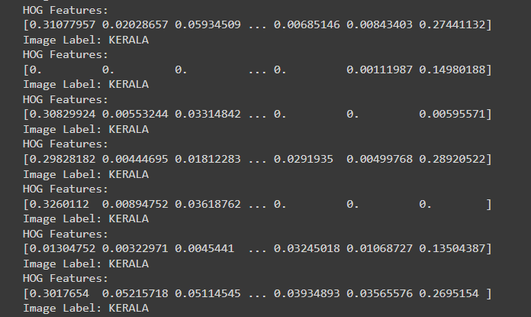
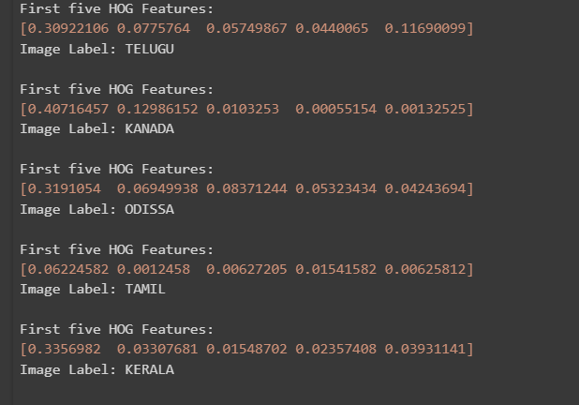
First 5 hog values
HOG feature extraction values

Slide 10
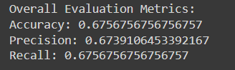
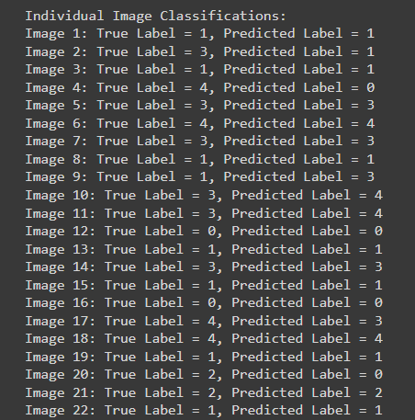
Results
Classification of segmented words
Metrics of our model

Slide 11
Conclusion
Performed preprocessing using techniques like morphological operations and edge detection on handwritten document images.
Used Histogram of Oriented Gradients (HOG) for studying shapes of character components.
Used 10-fold cross validation procedure and SVM classifier.
We were able to identify the enthnicity of individual handwritten image with an accuracy of 67.
The application of handwritten text analysis for state-level ethnicity identification presents a promising avenue for forensic and security applications.

Slide 12
THANK YOU

